Slide 1
React Life cycle
By Komal Singh

Slide 2
What are lifecycle methods in React?
React's component-based architecture empowers developers to create reusable and captivating user interface components.
This framework provides a comprehensive suite of lifecycle methods, allowing us to execute customized actions at various stages of a component's lifecycle.
In React, components have a lifecycle that consists of different phases. Each phase has a set of lifecycle methods that are called at specific points in the component's lifecycle.
These methods allow you to control the component's behavior and perform specific actions at different stages of its lifecycle.

Slide 3
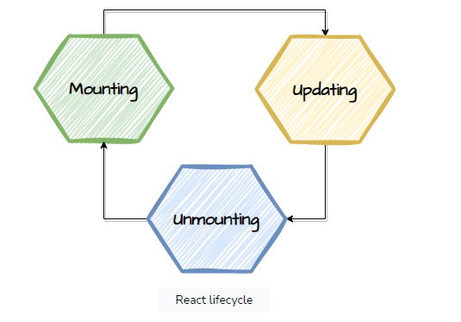
Mounting:
This is when a component is being created and inserted into the DOM.
Updating:
This phase occurs when a component is re-rendered due to changes in state or props.
Unmounting:
This is the phase when a component is being removed from the DOM.

Slide 4
React lifecycle methods
React lifecycle methods are predefined functions that are called at various phases of a React component's lifecycle.
These methods enable us to do specified actions such as initialization, rendering, updating, cleanup, and handling events at various stages of a component's life cycle, from creation to removal from the DOM.
Each React component undergoes a lifecycle that you can observe and manage through its three primary phases:
Component Mounting: The inception of your component (birth)
Component Updating: The evolution of your component (growth)
Component Unmounting: The conclusion of your component's existence (death)

Slide 5
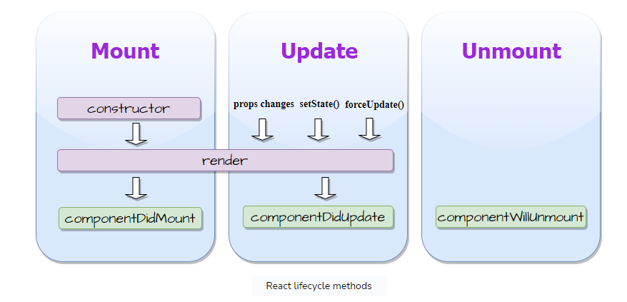

Slide 6
Component mounting
The mounting phase begins when a component is about to be rendered and inserted into the DOM.
During this phase, the 3 lifecycle methods are invoked i.e. constructor() , render() , componentDidMount().
Note: You can modify the component state within the componentDidMount() method, but it should be done with caution to avoid performance issues.
Constuctor()
When a component is formed, constructor() is the first method that is called. It sets the state of the component and binds event handlers.

Slide 7
Example
class MyComponent extends React.Component {
constructor(props) {
super(props);
this.state = {
count: 0
};
}
// ...
}

Slide 8
Render()
Render() method is responsible for rendering the component's JSX representation onto the screen. It returns the JSX code that describes what should be displayed.
class MyComponent extends React.Component {
render() {
return (
<div>
<h1>Hello, React!</h1>
</div>
);
}
// ...}

Slide 9
ComponentDidMount()
ComponentDidMount() method is called immediately after the component is mounted in the DOM. It is commonly used for fetching data from APIs or setting up subscriptions.
class MyComponent extends React.Component {
componentDidMount() {
// Fetch data from an API
fetch('https://api.example.com/data')
.then(response => response.json())
.then(data => {
// Update component state with fetched data
this.setState({ data });
});
}
// ...}

Slide 10
Component updating
The updating phase occurs when a component's state or props change. The lifecycle methods involved in this phase are shouldComponentUpdate(), render(),componentDidUpdate().
ShouldComponentUpdate()
ShouldComponentUpdate() method is called before the component is updated, allowing us to optimize performance by determining whether the component should re-render or not. It returns a boolean value

Slide 11
class MyComponent extends React.Component {
shouldComponentUpdate(nextProps, nextState) {
// Perform custom logic to decide whether to re-render or not
if (this.props.value === nextProps.value) {
return false; // Do not re-render
}
return true; // Re-render
}
// ...
}

Slide 12
ComponentDidUpdate()
componentDidUpdate() method is called immediately after the component is updated in the DOM. It is commonly used for performing side effects or updating the DOM based on new props or states.
Component unmounting
The unmounting phase occurs when a component is about to be removed from the DOM. The lifecycle method involved in this phase is componentWillUnmount().

Slide 13
ComponentWillUnmount()
componentWillUnmount() method is called just before a component is unmounted. It allows us to perform necessary cleanup tasks, such as removing event listeners or canceling subscriptions, to avoid memory leaks.
class MyComponent extends React.Component {
componentWillUnmount() {
// Clean up resources, such as event listeners or subscriptions
window.removeEventListener('scroll', this.handleScroll);
}
// ...
}

